Slide 1


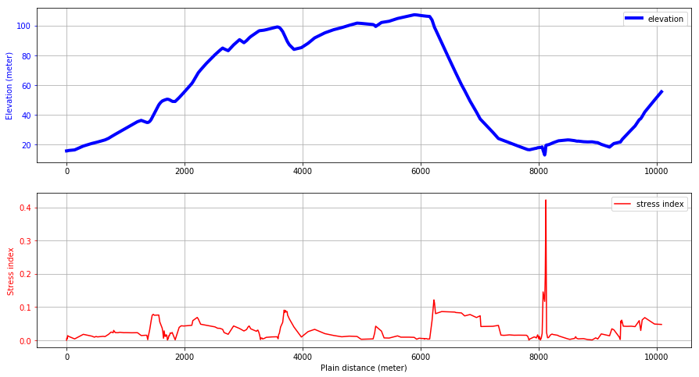
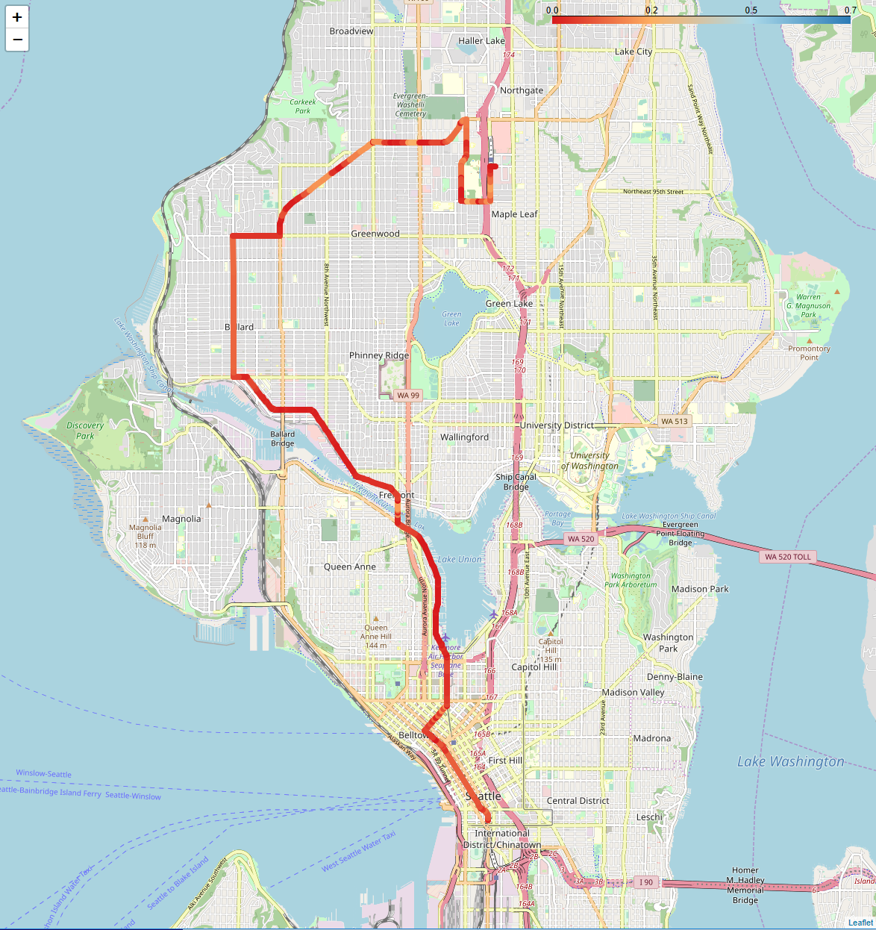
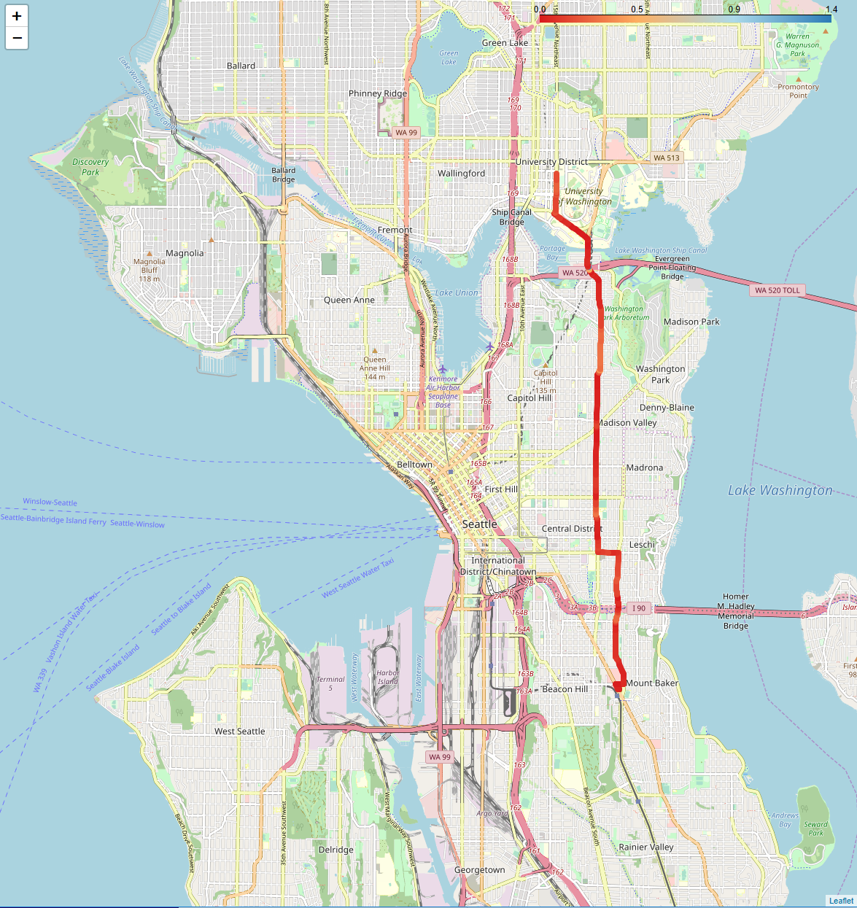
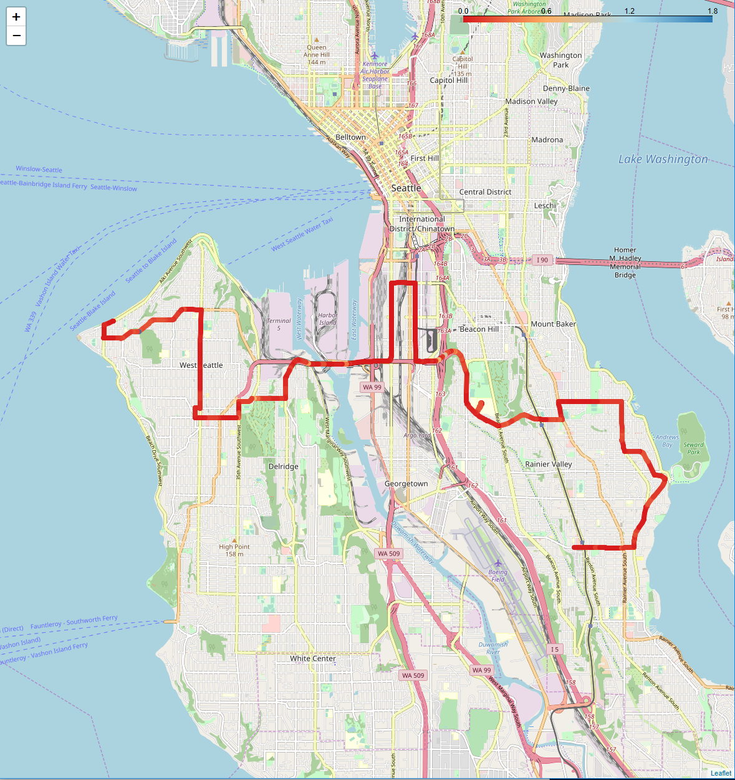
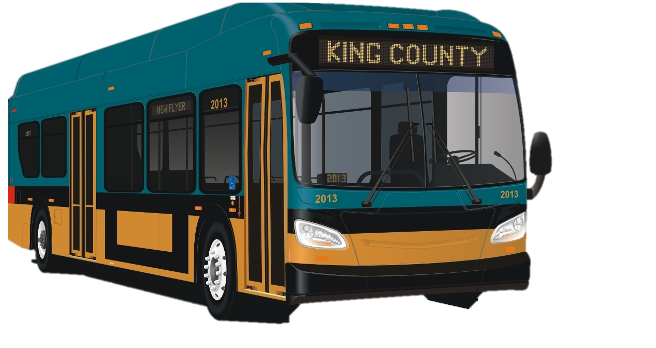
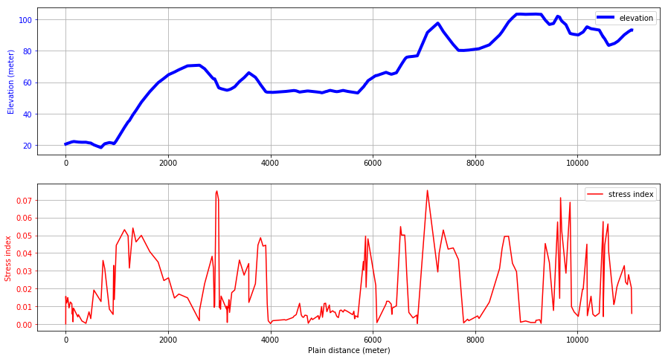
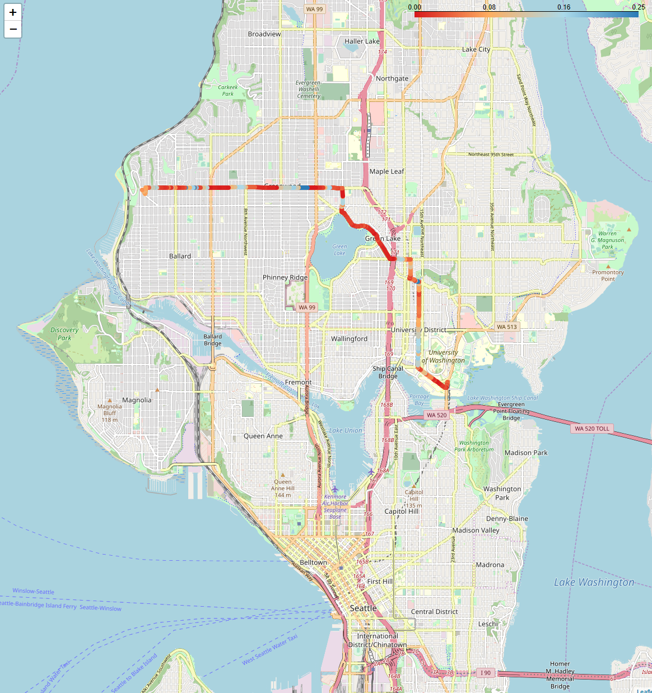
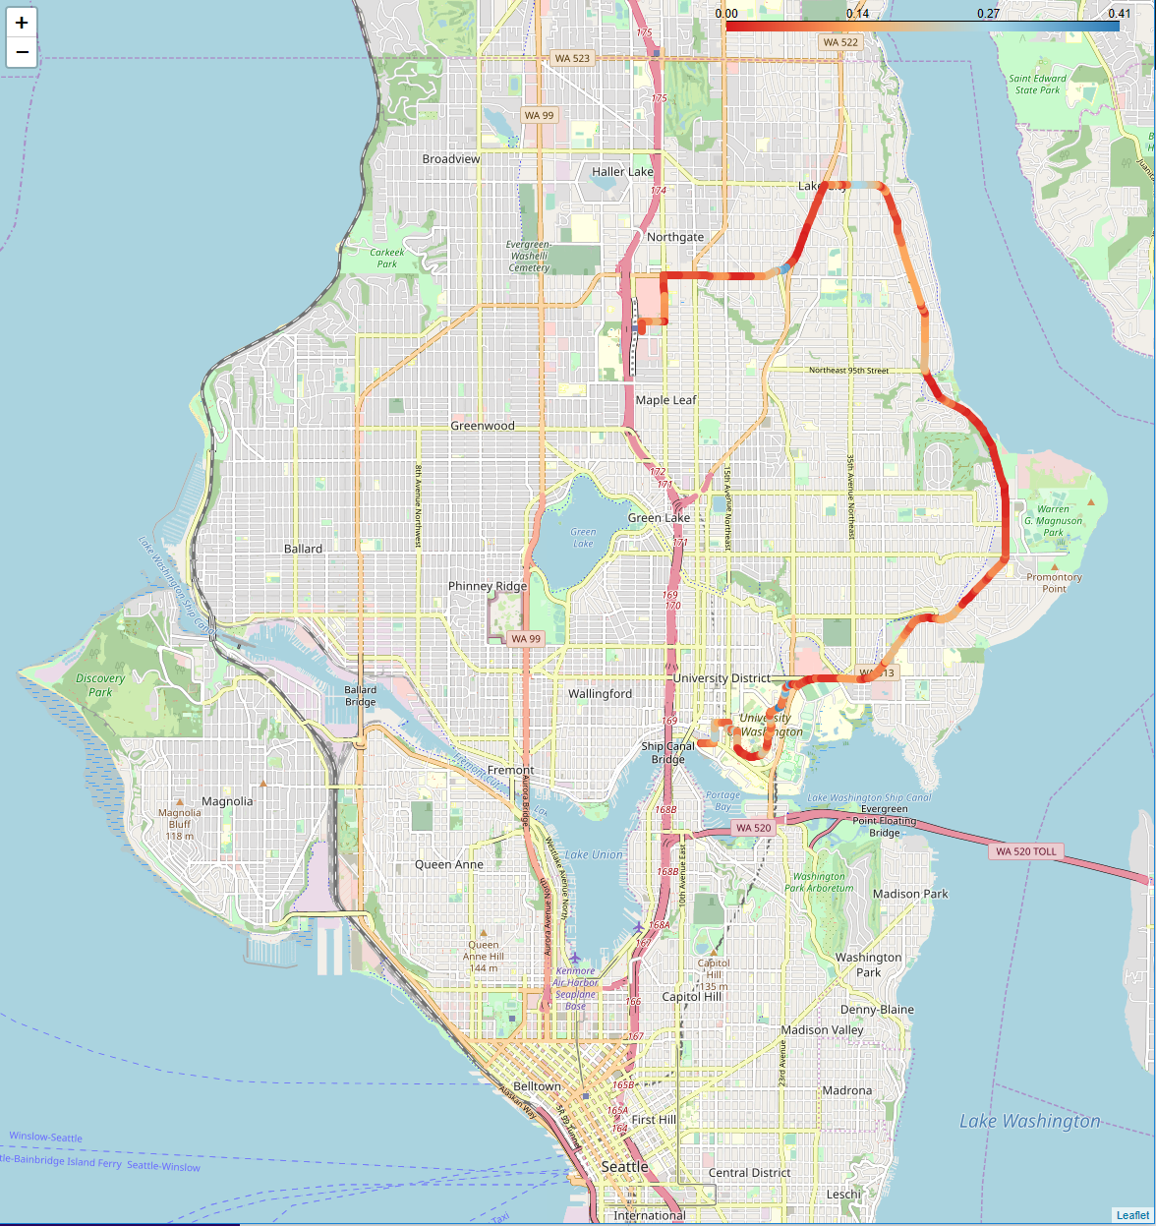
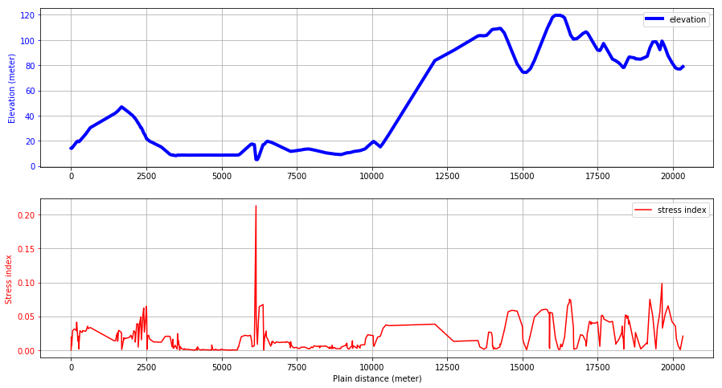
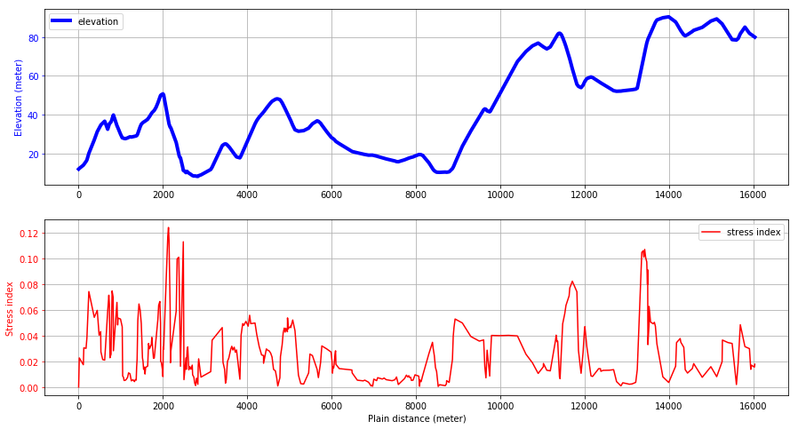
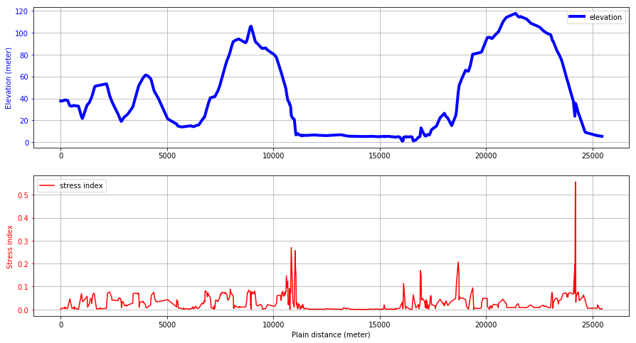


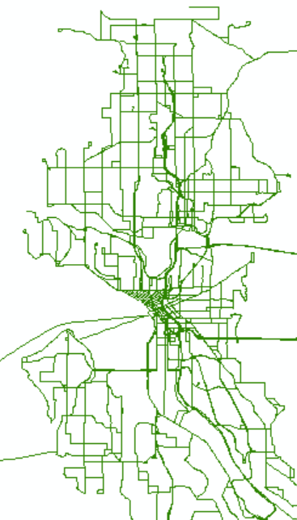
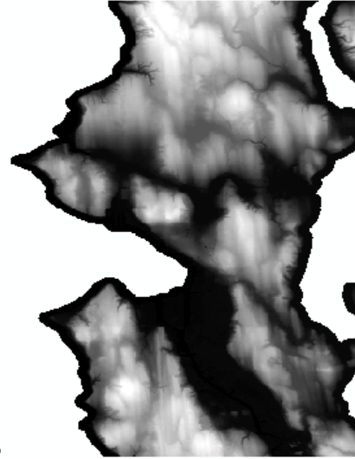
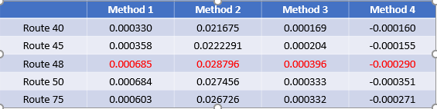
Visualizing King County Metro
Bus Routes
Atinuke Ademola-Idowu, Erica E. Eggleton, Yohan, KM
Objective
Results
Driving up and down hills is a source of stress for batteries in electrified vehicles. This software uses geographic information systems (GIS) data to determine the elevation profiles for King County Metro bus routes and rank the difficulty with regards to the batteries.
Work Flow / Packages
Read Data
Process Data
Analyze Data
Visualize Data
Bus route coordinates from King County Metro
Re-trace routes to extract only one-way bus routes
Extract elevation data for each bus route and merge with route coordinates into a GeoJson format
Display selected bus routes on map using colors to represent elevation gradient
Elevation profile for the King County area from Washington Department of Natural Resources
Convert elevation profile to coordinate system used by bus routes.
Display plots of selected bus routes’ actual elevation and absolute elevation gradient
Calculate route elevation gradient and compute different stress metrics
Current ranking metrics included in software:
1) Metric = sum(grade) / total route distance
2) Metric = sum(|Elevation distance between points|)/ total route distance
3) Metric =
4) Metric =
Packages
Geopandas
Shapefile
Rasterstats
Pandas
ArcGIS/ArcMap
Geopandas
Rasterio
Geopandas
Shapely
Geopy
Pandas
Numpy
Folium
Matplotlib
Branca
Json
 | Method 1 (10⁻⁴) | Method 2 (10⁻²) | Method 3 (10⁻⁴) | Method 4 (10⁻⁴)
Route 40 | 3.30 | 2.17 | 1.69 | -1.60
Route 45 | 3.58 | 2.22 | 2.04 | -1.55
Route 48 | 6.85 | 2.88 | 3.96 | -2.90
Route 50 | 6.84 | 2.75 | 3.33 | -3.51
Route 75 | 6.03 | 2.67 | 3.32 | -2.71
Data Types / Cleaning
Routes were re-traced to avoid repeated points from multiple directions
Shapefile and raster file must use the same coordinate system.
Future Work
Add more parameters to get a better estimate of battery stress
Interpolate grade between points
References:
Bus routes: Shapefile (.shp)
Elevation: Raster file (.tif)

